Slide 1
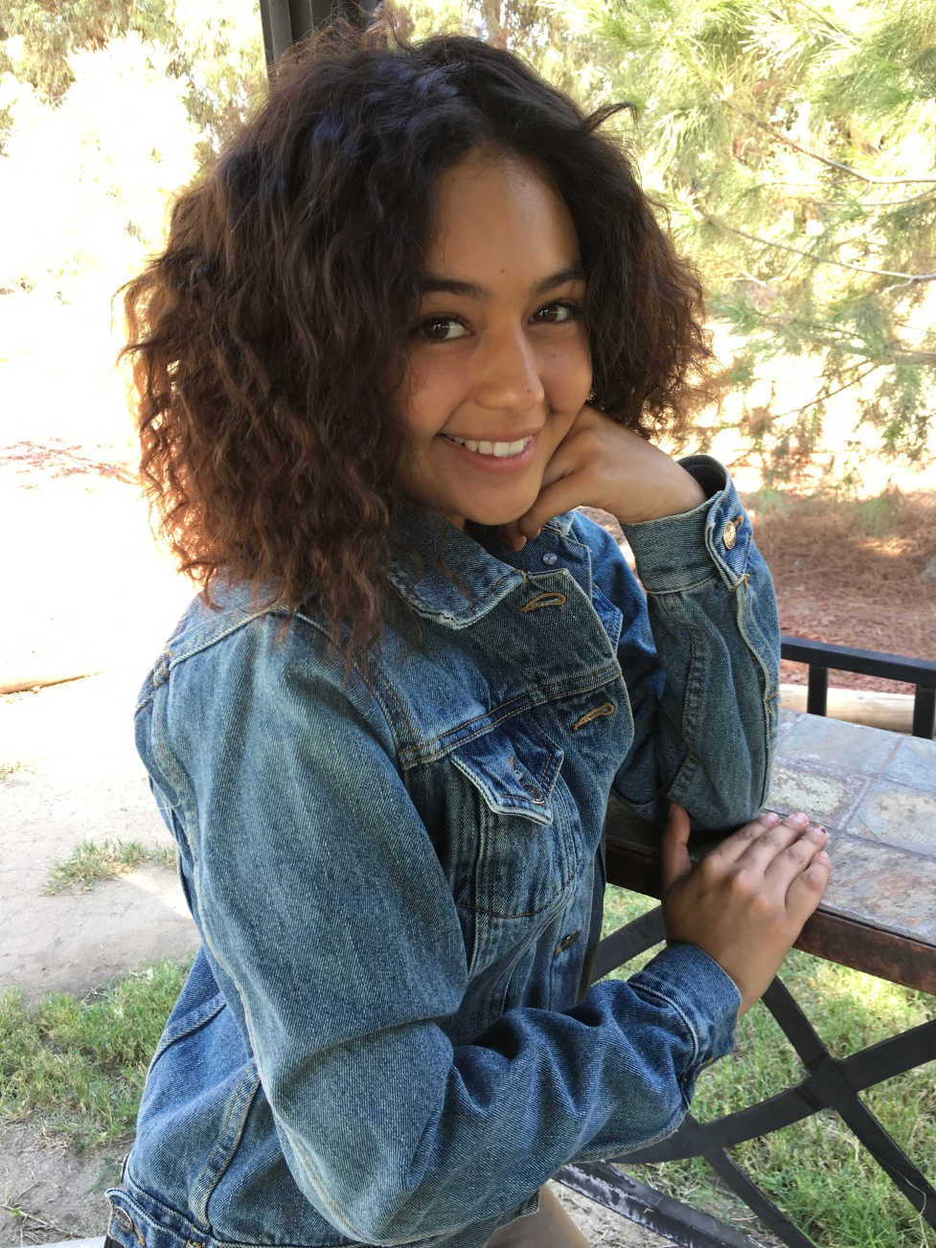
Anayh Acevedo

Slide 2
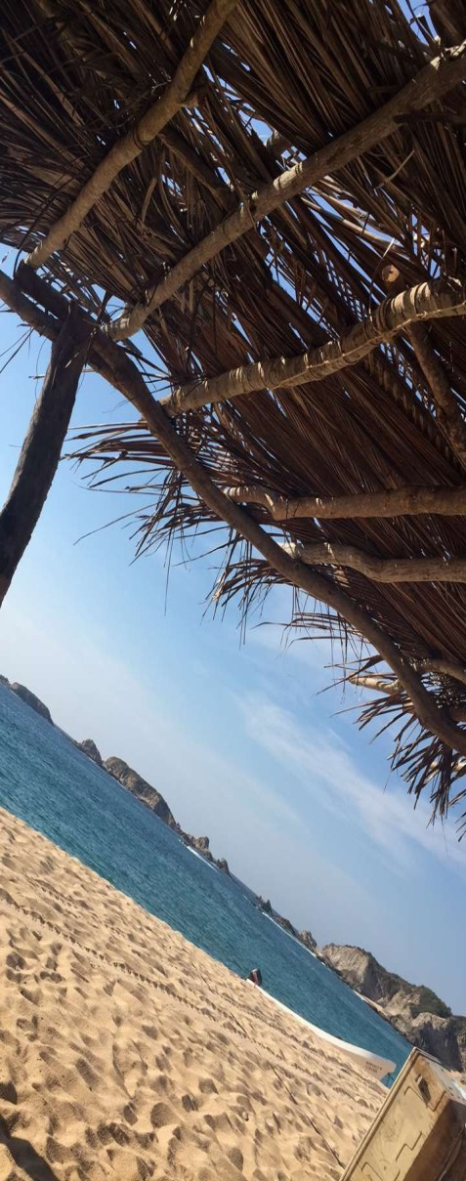
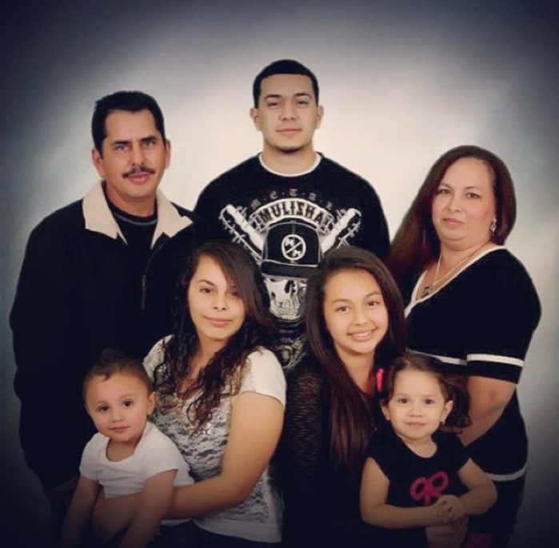
About Me
Family of 6
Adopted brother
Parents come from Mexico
BIG hardship
Notes:
I come from a family of 6 My mom who is 44 my dad who is 51 my older brother who is 26 my older sister who is 23 and a younger brother who is 5. When I was 12 my family got a call to take in a newborn through fostercare who was taken from his birthmother because of the amount of drugs in his system. We instantly fell In love with him and knew he was so special. He is half Native American and half Mexican. Ever since then he has been a part of my family and we always seem to forget he is adopted because we have grown so much to love him as our own. My parents came from Mexico and that is a huge part of who I am because my entire family lives there, we are the only ones who live here. My parents met when my mom was 16 and my dad was 23 and they married a few months after. They moved here to give us a better life. We always go back and visit the roots from where we came from. My life has always been pretty smooth because of my parents but they could not keep me away from life and what comes with it. When I was 9 my best friend was in a horrible car accident and she was admitted into the childrens hospital but as much as they tried to save her they could not. My parents tried to help me through the pain but it was harder than they could imagine. It was not an easy time for me but I like to think that this shaped the way I think of life and to do and go after what I love because it can be taken from you in an instance.

Slide 3
My High School Experience
Honors Guitar
Golf
Swimming
NSHS
AP Classes
Notes:
During High school I have been in different activities. One of my most passionate is Honors Guitar. I started the guitar program my sophomore year and by junior year Ms. Wills the guitar instructor asked me to be apart of the Honors Guitar club which made me want to learn more and more about guitar. Last year we accomplished so much with the group and performed two of the carmen suites arranged by the LA quartet group at CMEA and got a command performance which was very exciting. I have also been involved for four years in swimming and three years in golf. Reap has also been apart of my high school experience because it pushed me to get level 4’s so that I can get more scholarship money. Over all I have taken 6 AP courses throughout my four years which I think really has prepared me to be

Slide 4
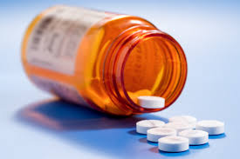
Job Shadow
Pharmacist Technician
Bianca Garcia
Closest thing to a medical profession that had enough time

Slide 5
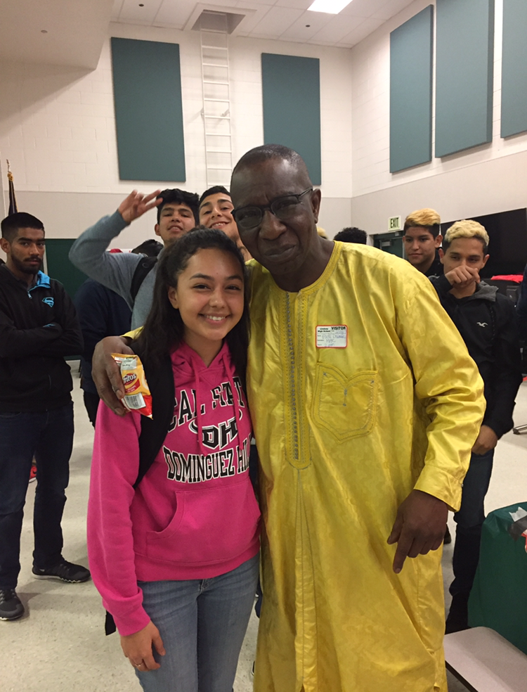
Pathway
French
Trilingual
Medical
pathway

Slide 6
Post High School Plans
Attend a 4 year university
Fresno State
UC Davis
UC Santa Cruz

Slide 7
Leaving LHS
Accomplished
Ready for the future
PBS
Independent

Slide 8
Questions?

